Slide 1
Digital Portfolio
STUDENT NAME :A.Gokulakrishnan
REGISTER NO AND NMID:222404555/0B3560C62FAAC73AFC54FD40957982E6
DEPARTMENT: B.Sc Software Application
COLLEGE: COLLEGE/ UNIVERSITY:A.M jain college

Slide 2
PROJECT TITLE DIGITAL PORTFOLIO

Slide 3


AGENDA
Problem Statement
Project Overview
End Users
Tools and Technologies
Portfolio design and Layout
Features and Functionality
Results and Screenshots
Conclusion
Github Link
3/21/2024 Annual Review

Slide 4

PROBLEM STATEMENT 1)Building the structure 2)Giving perfect colors 3)Inserting pictures 4)Making scrolling smooth 5)Making it responsive

Slide 5

PROJECT OVERVIEW A digital portfolio fully attached my skills in the software world and also it holds my project I have linked my github,linkedin,twitter profile

Slide 6

WHO ARE THE END USERS? The end users are … The companies I go for interview My online clints

Slide 7

TOOLS AND TECHNIQUES HTML CSS JAVASCRIPT

Slide 8
POTFOLIO DESIGN AND LAYOUT
It has a maginificent Purple blended violet colors and it has my profile photo , My name in the Starting after scrolling down you can find my projects , and what Skills do i have and lastly you got a information box to fill up your details and get in touch with me...
- Thank you!!

Slide 9
FEATURES AND FUNCTIONALITY Displays My Essential Details Scrolls Smootly it has a Arrow button in the left to scroll up from down

Slide 10
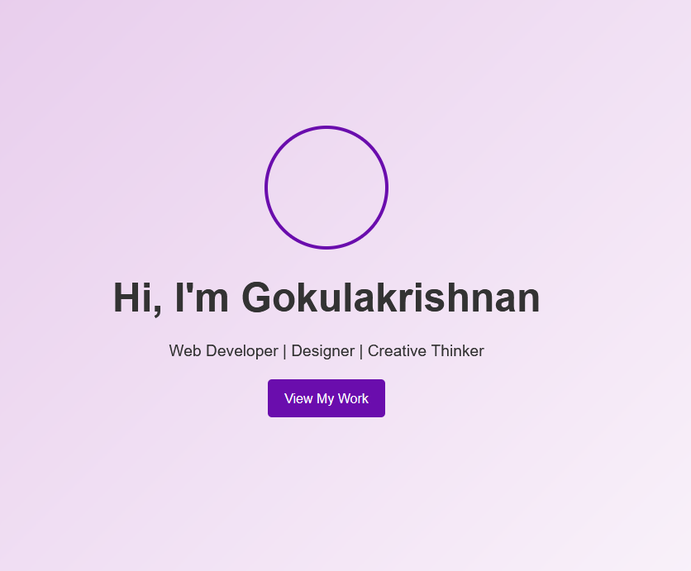
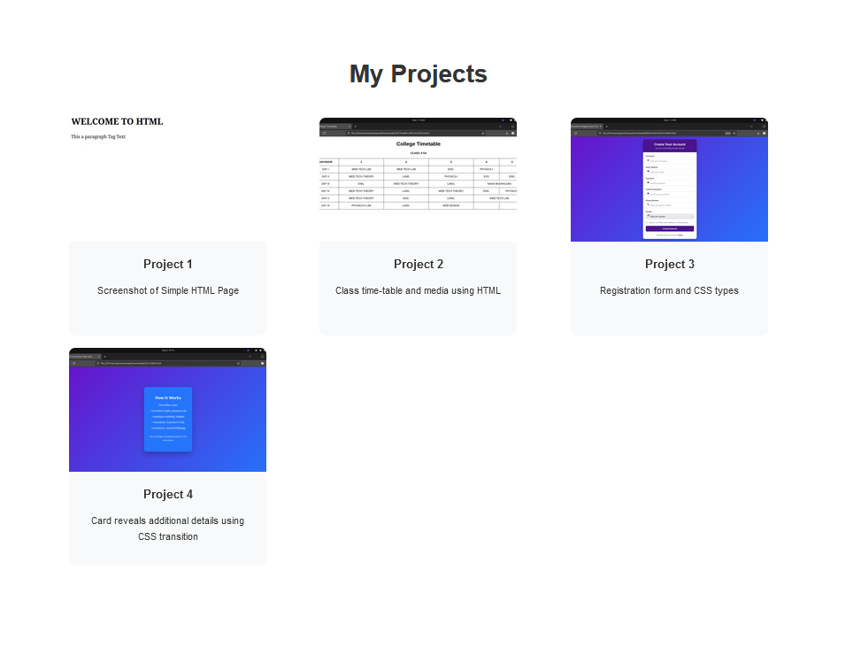

RESULTS AND SCREENSHOTS
3/21/2024 Annual Review

Slide 11
CONCLUSION I have created this Portfolio with my Hardwork and consistency
Portfolio link: https://02-gokulakrishnan.github.io/TNSDC-FWD-DigitalPortfolio/
Github link : https://github.com/02-gokulakrishnan/TNSDC-FWD-DigitalPortfolio.git

